Slide 1

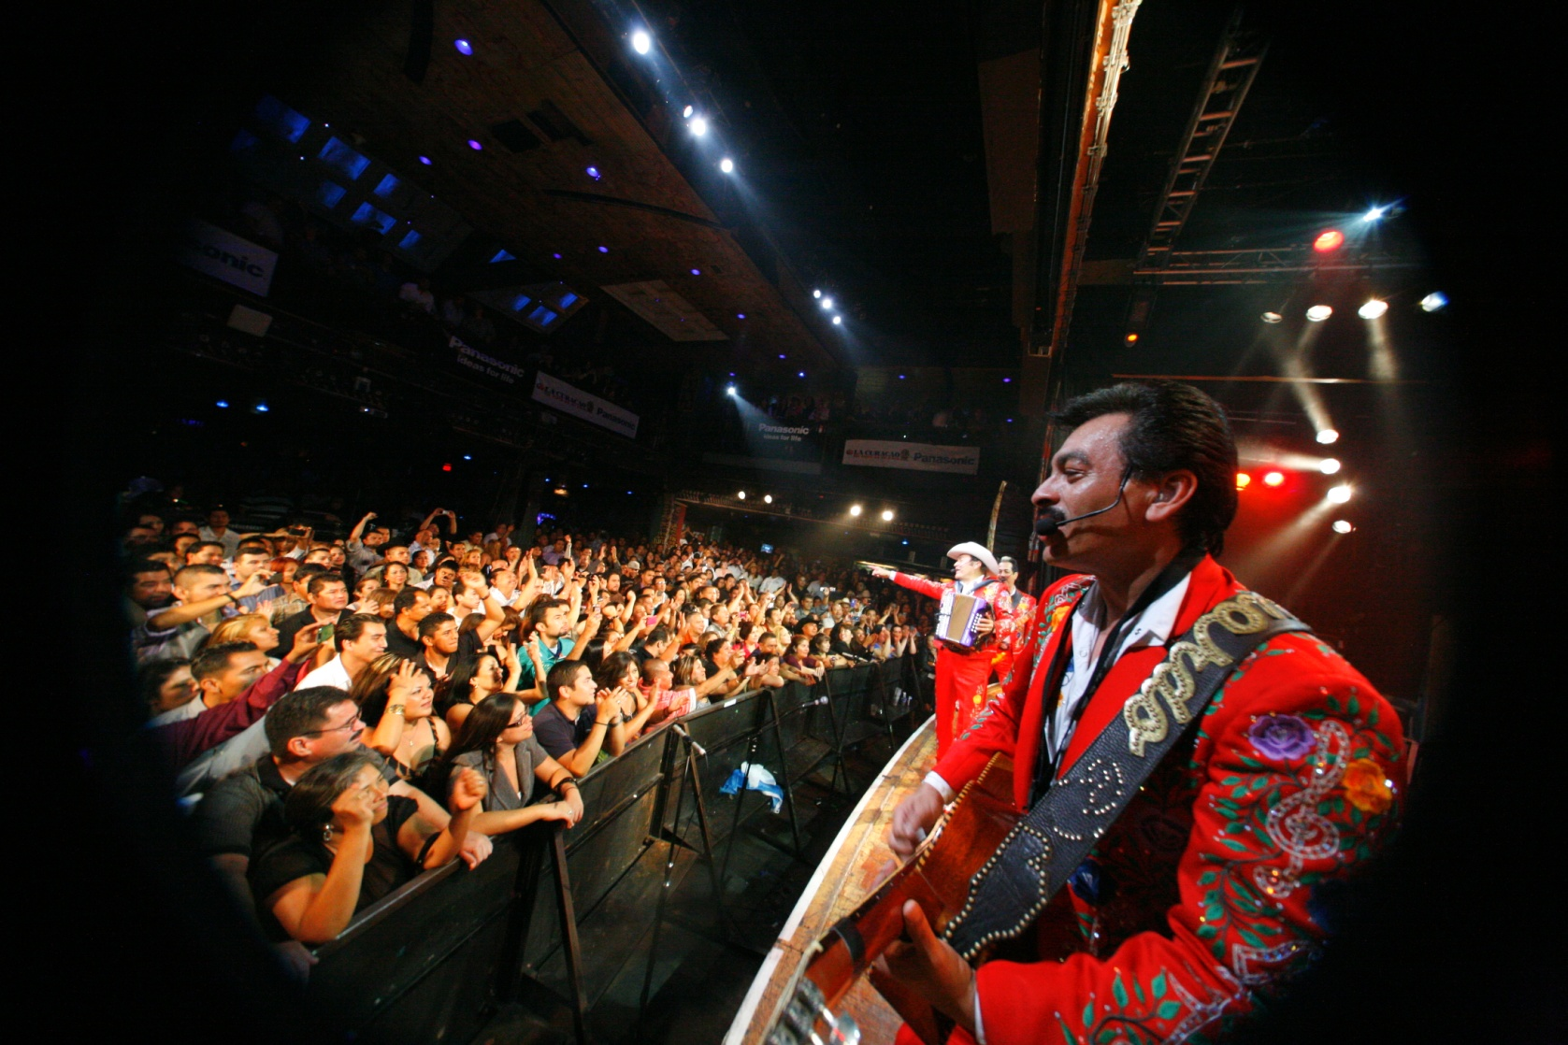

P R E S E N T S :
RECAP PRESENTATION
LOS TIGRES DEL NORTE
@
The HOB
Sunset
August 31, 2011
8:00PM
Produced By:

Slide 2
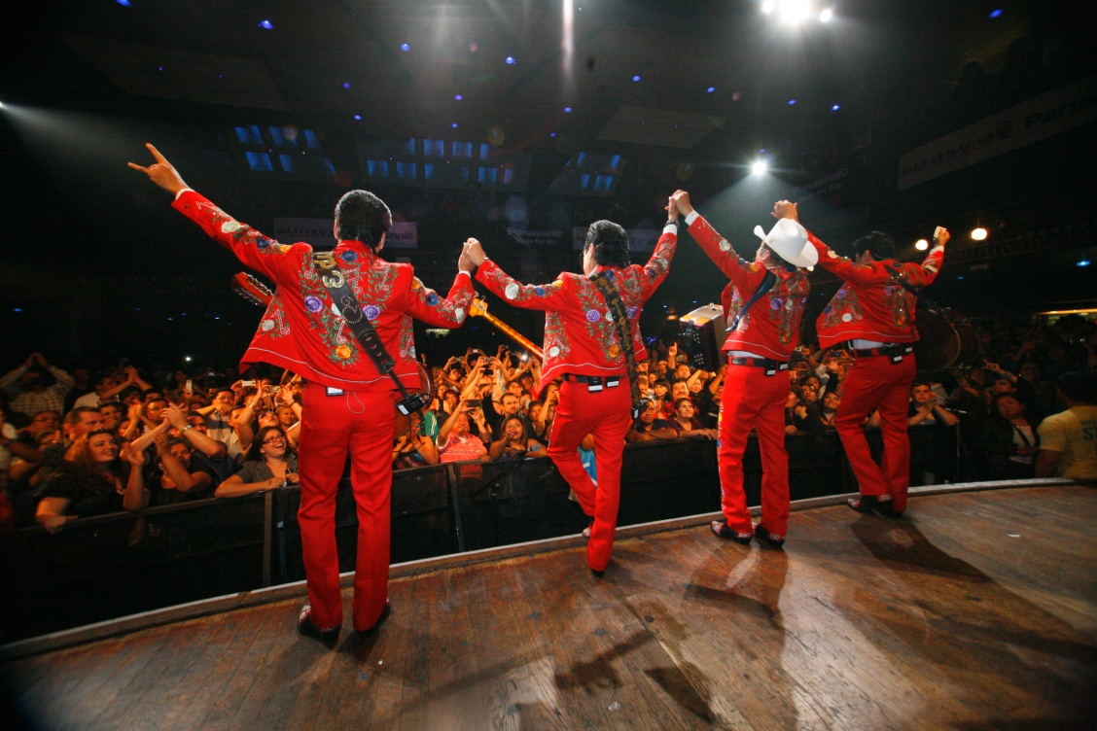
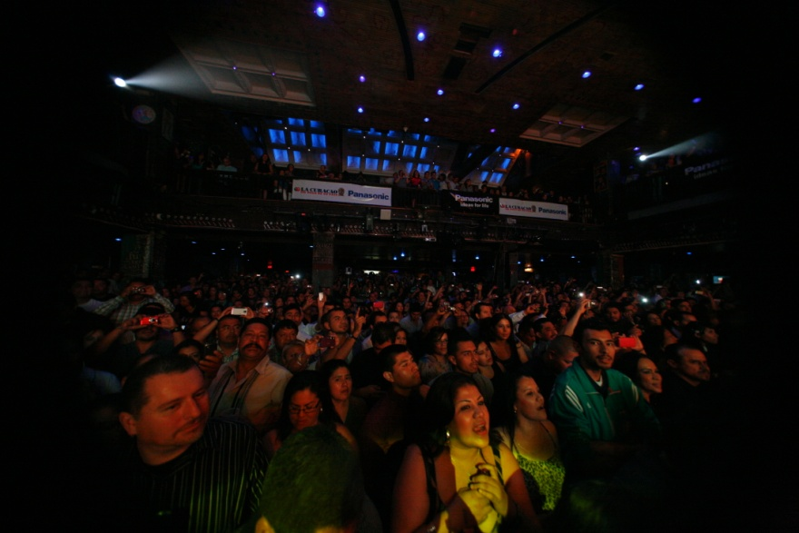
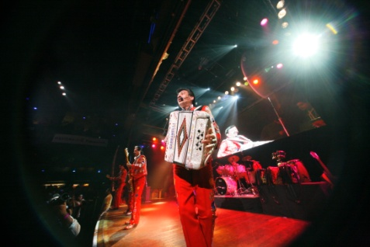
RECAP PRESENTATION
The Event:
ACA Marketing produced another private concert for PANASONIC
ACA Marketing has secured the biggest act in the Regional Mexican Music genre: LOS TIGRES DEL NORTE
The event took place at the legendary venue The House of Blues in Sunset strip on August 31, 2011
The event was very exclusive; for only 1,100 people.
    Tickets to the event were only available by purchasing a Panasonic Product
    This event helped significantly the sales of Panasonic products
    VIP area for M&G with artist for Panasonic guests

Slide 3

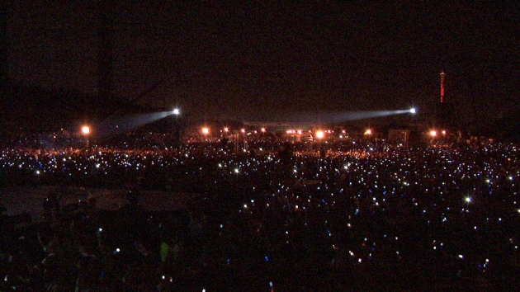
Who are ?
RECAP PRESENTATION
Sold over 35 million records
Released over 55 albums
Recorded over 500 songs
Appear in over a dozen films
Millions of hits in YouTube
Received the Latin Recording Academy's Lifetime Achievement Award.
Millions of searches on Goggle monthly
14 times nominated to the Grammy
“The biggest on their genre” (New York Times)
“The most influential Regional Mexican Group” (Billboard Magazine)

Slide 4

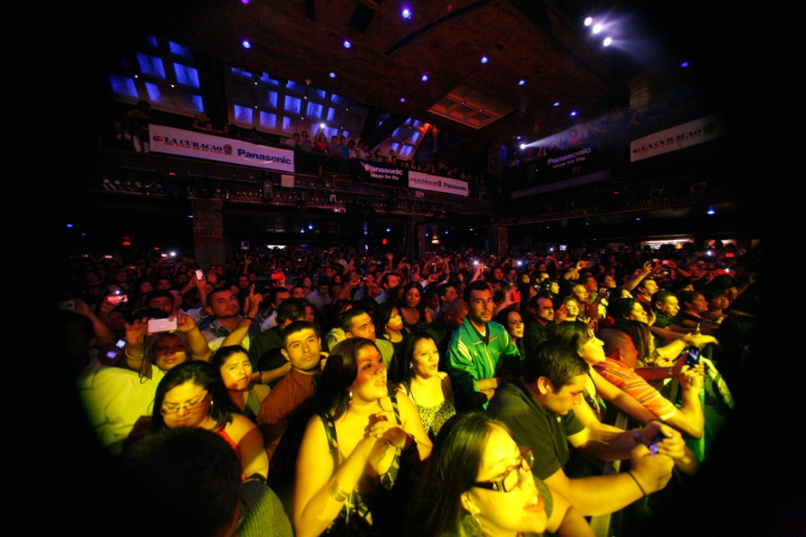
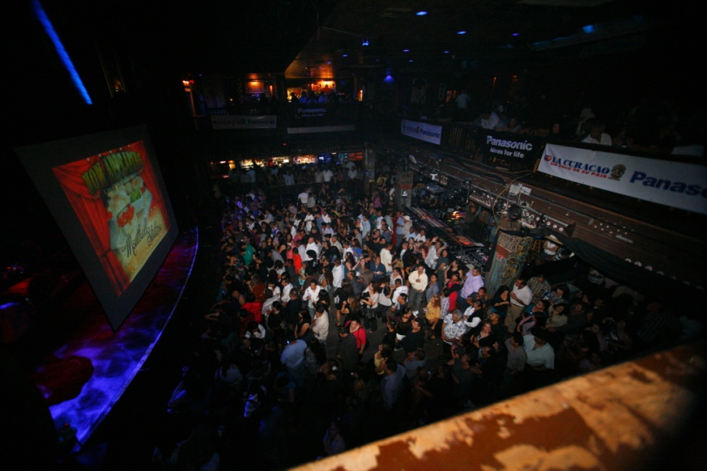
RECAP PRESENTATION
The Goal- Our Partner:
To continue the Concert Series establishing Panasonic’s presence with the Latin Community.
To help establishing a better relationship with #1 vendor: La Curacao by inviting them to be the exclusive partner on this important event
To increase sales utilizing the concert tickets as an incentive for customers
  To help our partner La Curacao to drive traffic to their stores by offering the opportunity to win tickets to this private event with this special promotion.
  To bring an unique experience to Panasonic and La Curacao’s customers and employees
  To continue bringing an event that has the dynamic of motivating both the Panasonic/La Curacao’s customers and employees

Slide 5


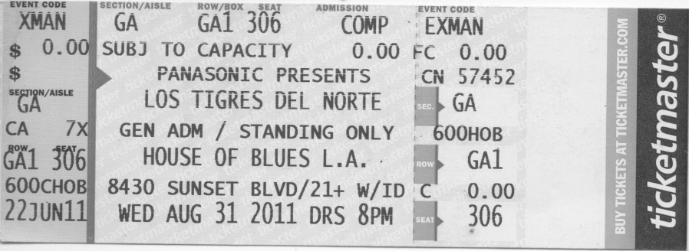
RECAP PRESENTATION
Benefits:
Panasonic was again the “Title Sponsor” for one of the hottest concerts of the year!
Panasonic received La Curacao’s massive media buy to promote event including radio, TV, print, database, catalog, bill statement insert, etc.
Panasonic had the right to utilize Los Tigres del Norte’s name, logo and image for this promotional campaign Tickets are only available when purchasing a Panasonic TV
Los Tigres del Norte gave special price to Panasonic to have 1,000 cd’s of newest album (MTV Unplugged) to also use as an incentive to purchase a Panasonic recorder by giving it away for free!
Flyers were distributed at all La Curacao Stores 2 weeks prior the concert
The first MTV Unplugged of Regional Mexicana Genre
# 1 in Sales in several countries (By Soundscan )
USA Gold Album in USA and # 1 in Sales
Mexico Double Platinum in Mexico and # 1 in sales for 3 consecutive weeks
2,000 Tickets were given away @ La Curacao stores when purchasing A Panasonic Product

Slide 6
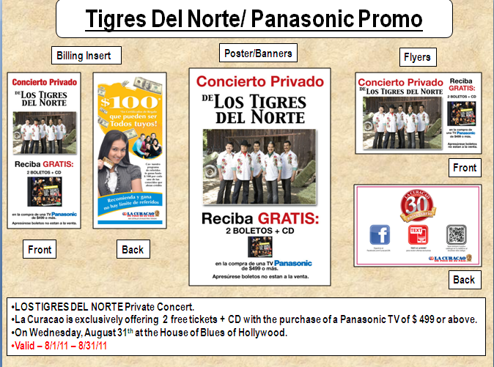
RECAP PRESENTATION
Billing insert with promotion was sent to over 400,000 active La Curacao clients with concert /promo information
RADIO STATIONS | # Spots
 | 30" sec
KSCA La Nueva 101.9 | 40
KBUE FM | 80
KHJ Ranchera | 12
 | 132
TV STATIONS | 15" sec
KMEX 34 | 10
KWHY 22 | 11
KVEA 52 | 32
KRCA 62 | 40
 | 93
Banners were set up outside each La Curacao store and at the electronics department

Slide 7

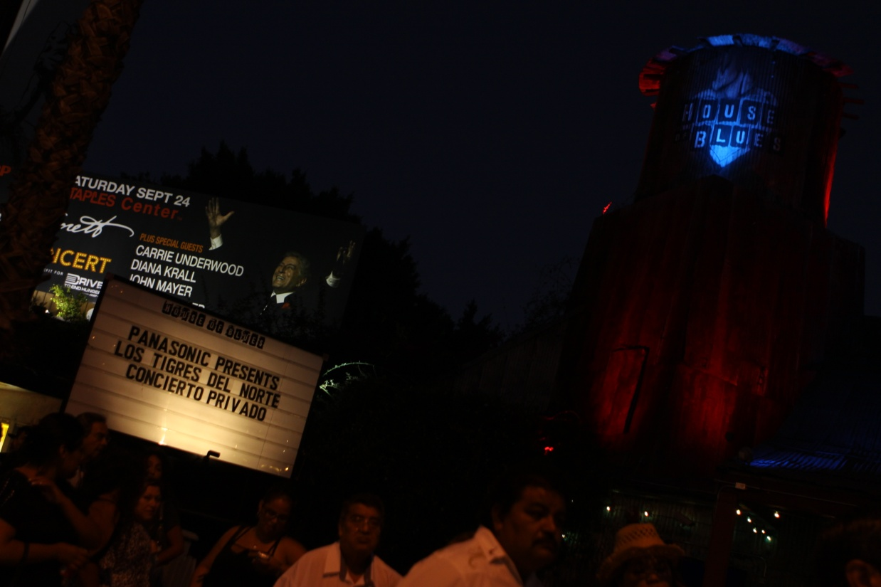
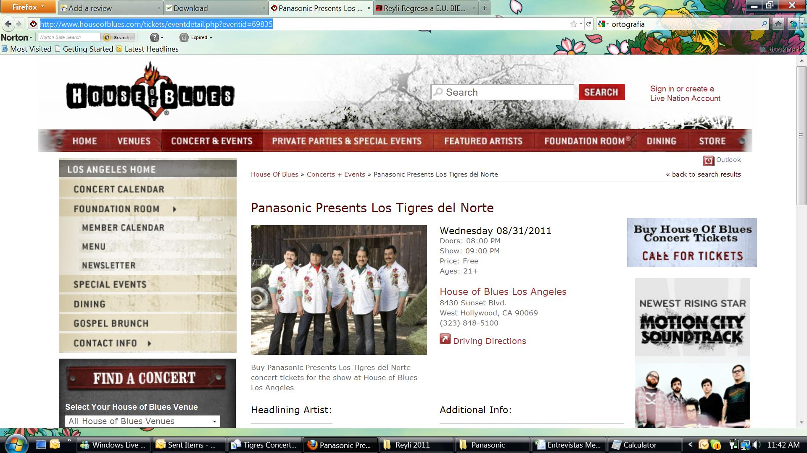
.
RECAP PRESENTATION
Panasonic was labeled as presenting sponsor at venue’s marquee on Sunset Strip
Panasonic presence at HOB Website on calendar section

Slide 8
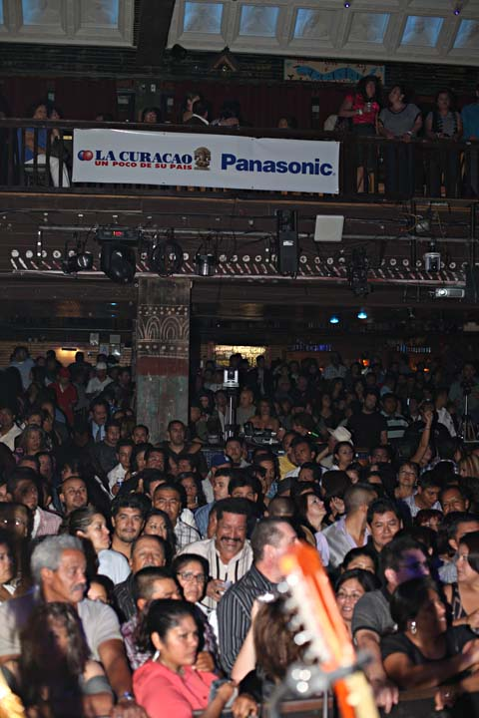
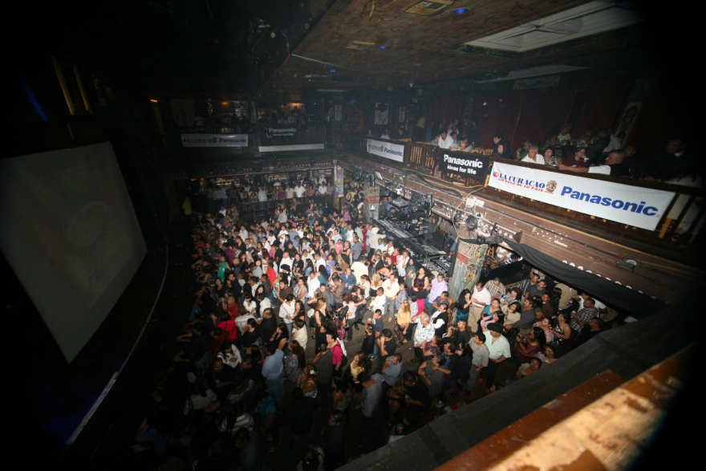
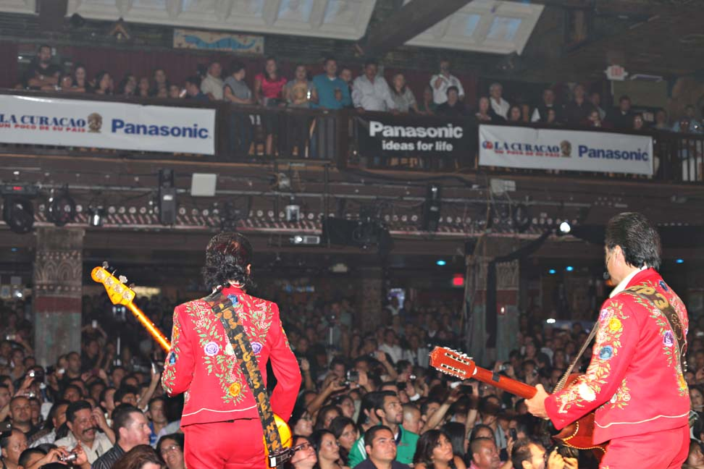
RECAP PRESENTATION
There was extensive signage at venue during the concert

Slide 9
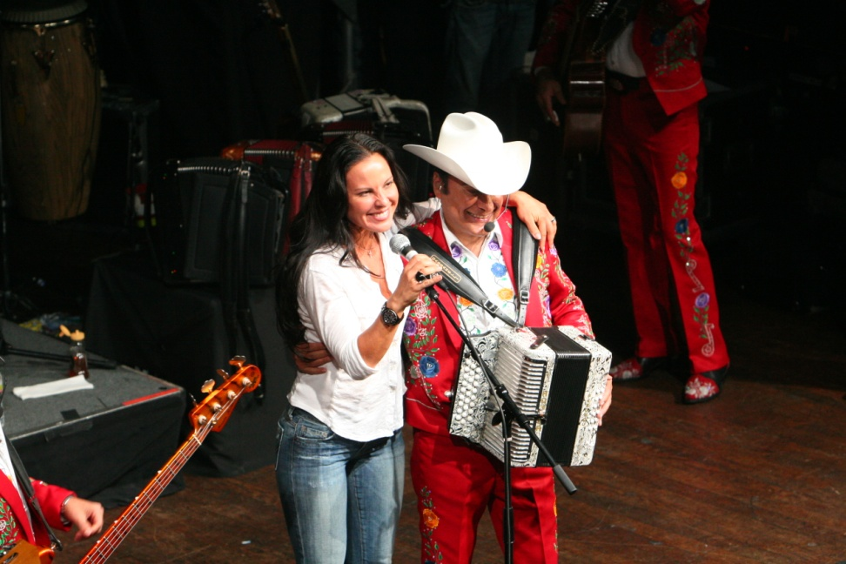
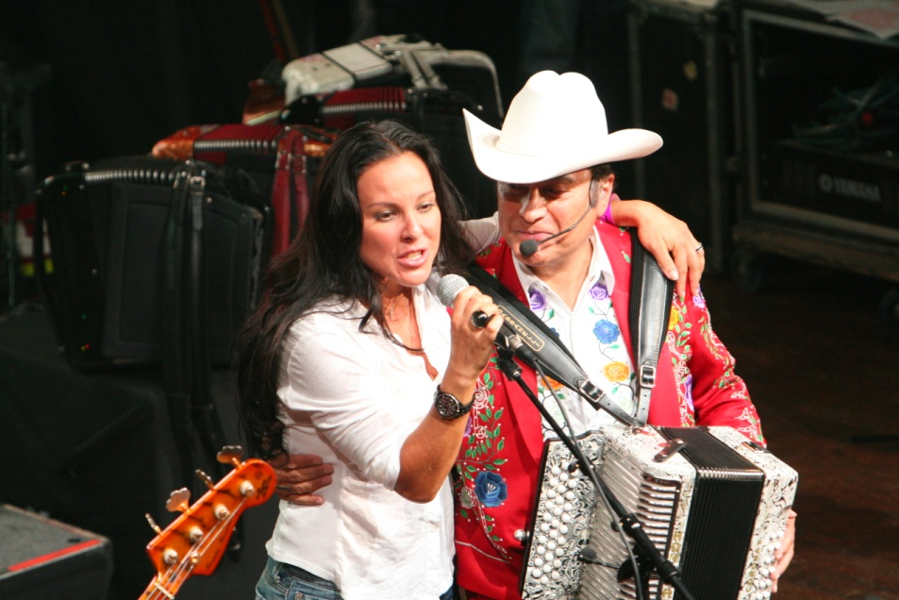
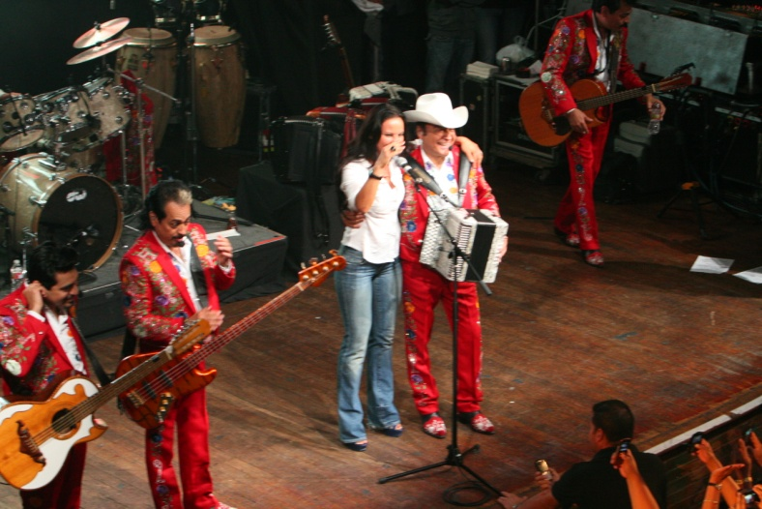
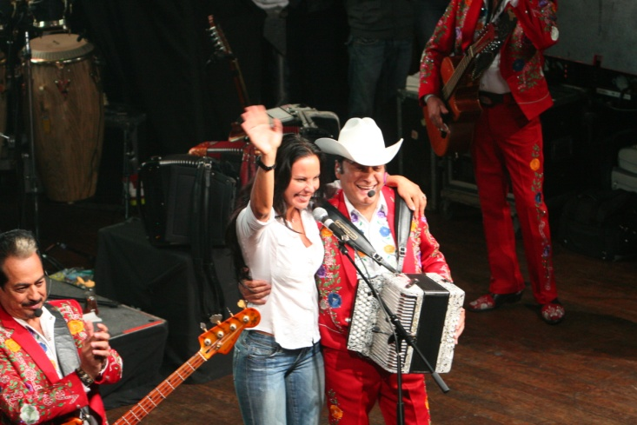
2
RECAP PRESENTATION
Special Appearance of International Celebrity Kate del Castillo

Slide 10
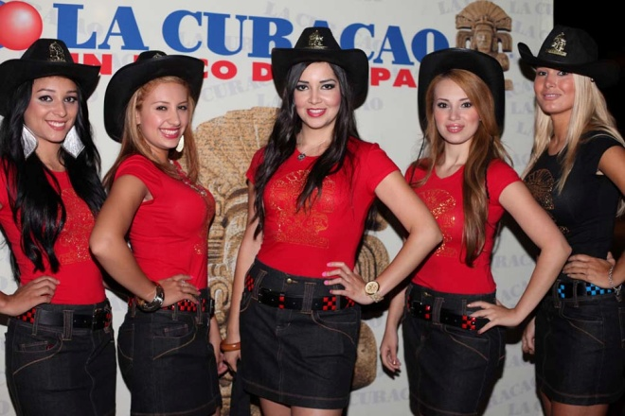
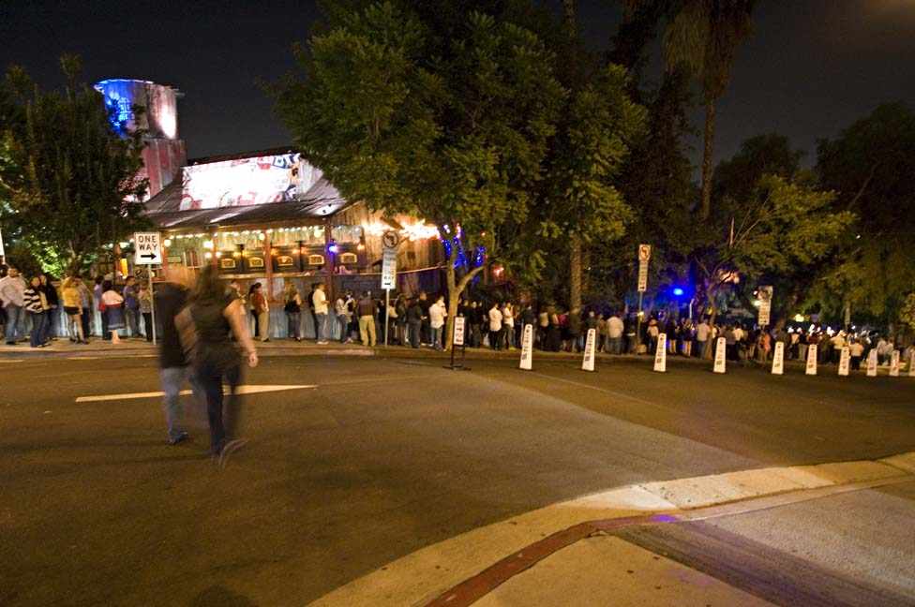
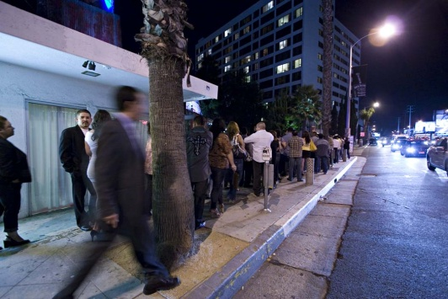
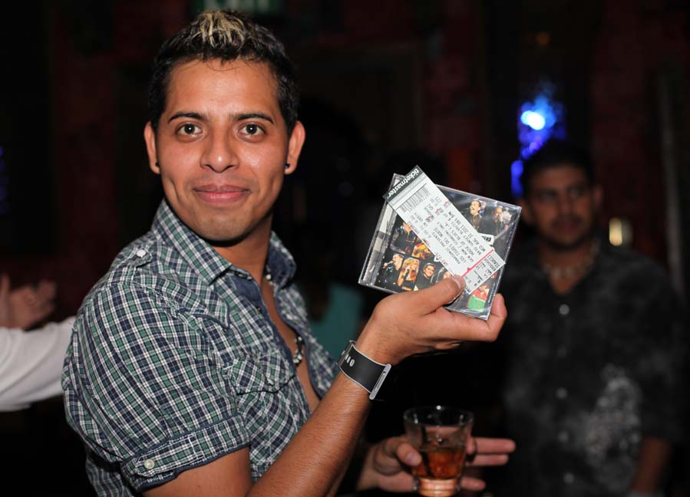
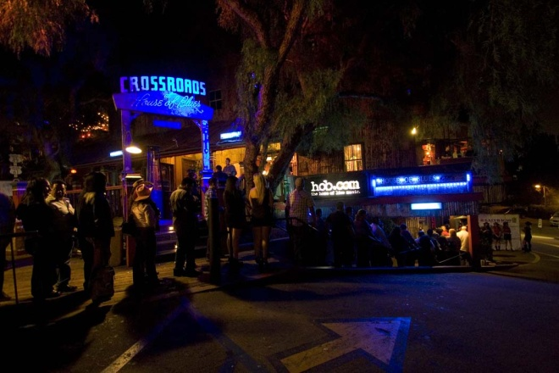
RECAP PRESENTATION
Special area for La Curacao’s promotions team & Panasonic 3D display onsite
Event was packed! Line to enter was all around Sunset Strip
Panasonic/La Curacao customer

Slide 11
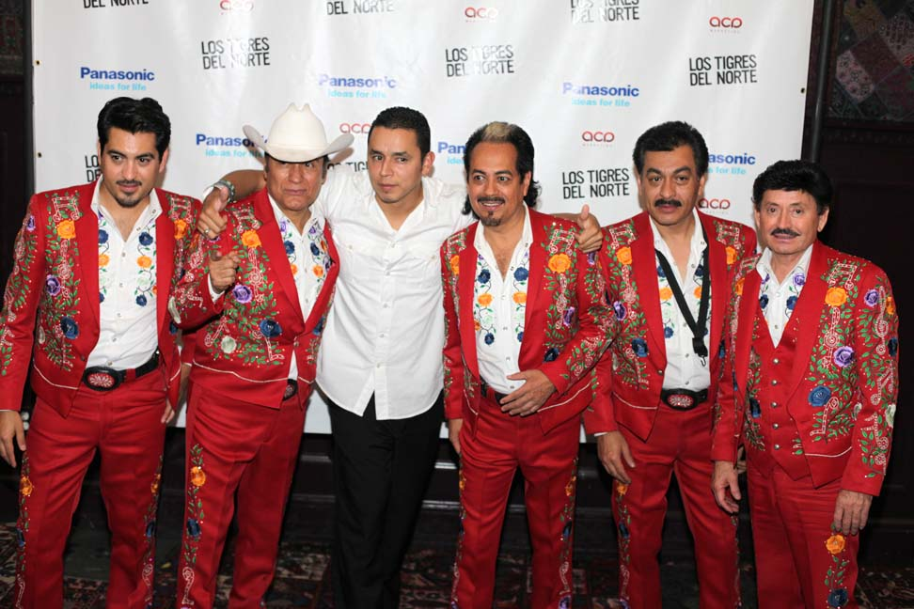
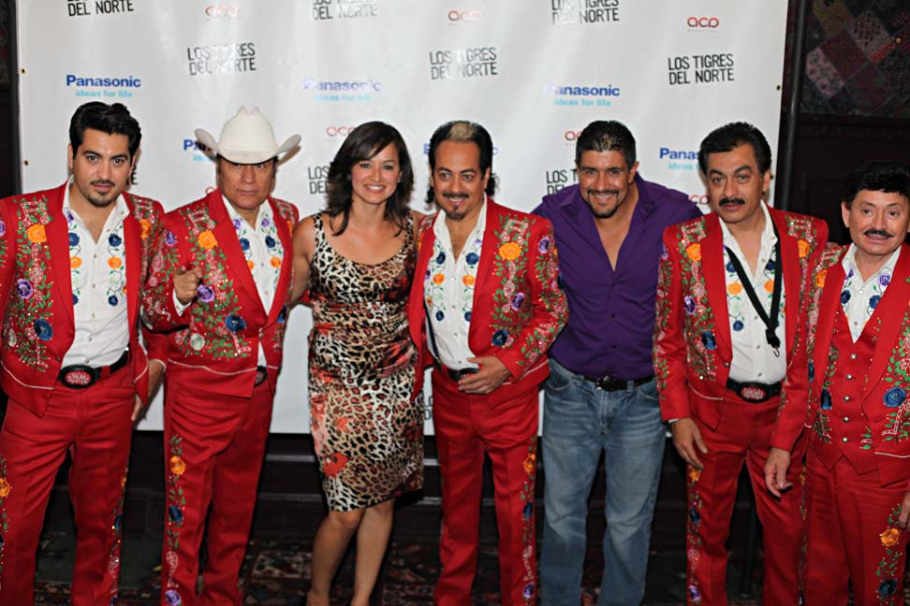
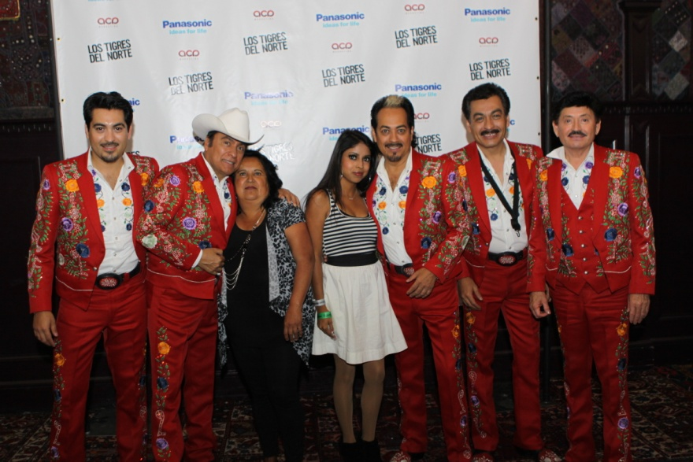
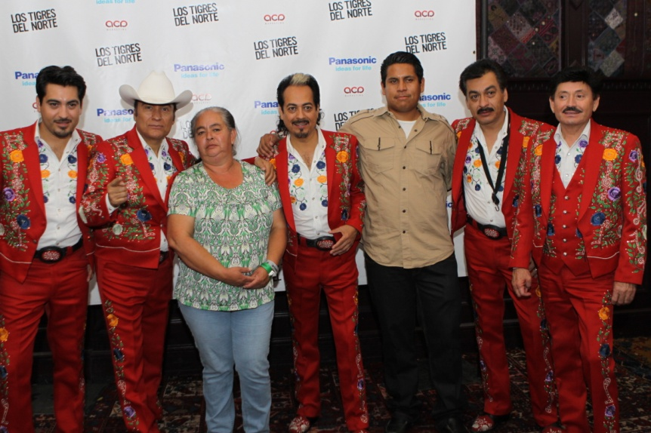
VIP
VIP
RECAP PRESENTATION
There was a VIP area for special Panasonic & La Curacao’s guests for M&G with Los Tigres del Norte

Slide 12
RECAP PRESENTATION
THE EVENT: WAS VERY SUCCESFULL WITH A FULL HOUSE ON A WEDNESDAY NIGHT!
THE CUSTOMERS: OVER 1,200 PEOPLE HAD THE OPPORTUNITY TO SEE UP AND CLOSE LEGENDARY REGIONAL MEXICAN BAND LOS TIGRES DEL NORTE THANKS TO PANASONIC!
THE PRODUCT: MORE THAN 1,300 PANASONIC TV’s WERE SOLD IN 2 WEEKS!!!
  We look forward to continue working this partnership with Panasonic and to the next concert!

Slide 13
RECAP
PRESENTATION
Produced by:
www.acamarketing.net
www.facebook.com/acamarketing
Twitter.com/acamarketing

