Slide 1

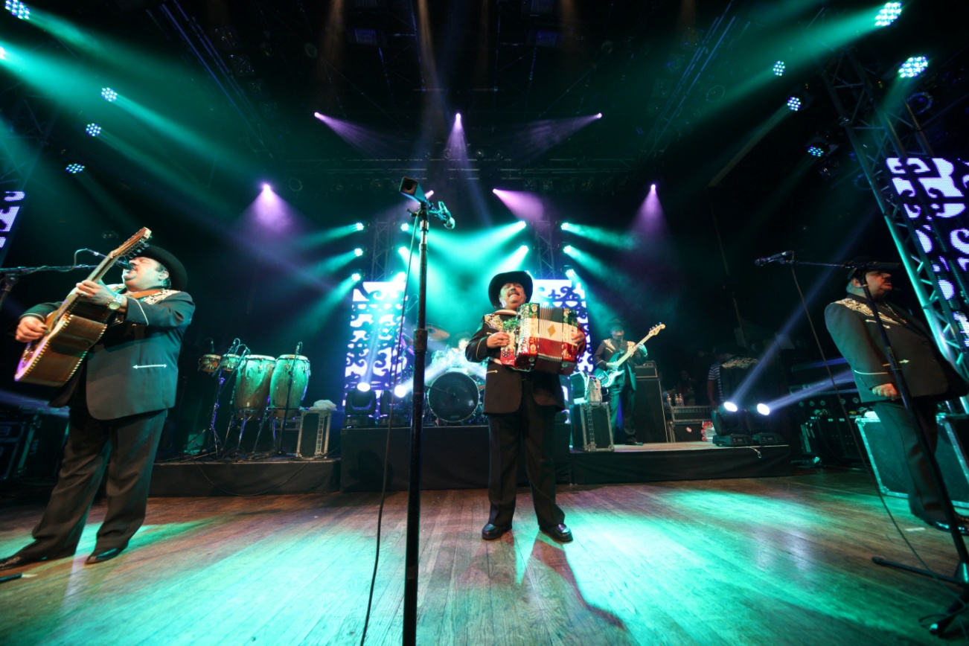

RECAP PRESENTATION
ITS 4TH PRIVATE CONCERT
Featuring
P R E S E N T S:
RAMON AYALA
@
The HOB
Sunset
May 2, 2013
8:00PM
&
Sponsored by:

Slide 2
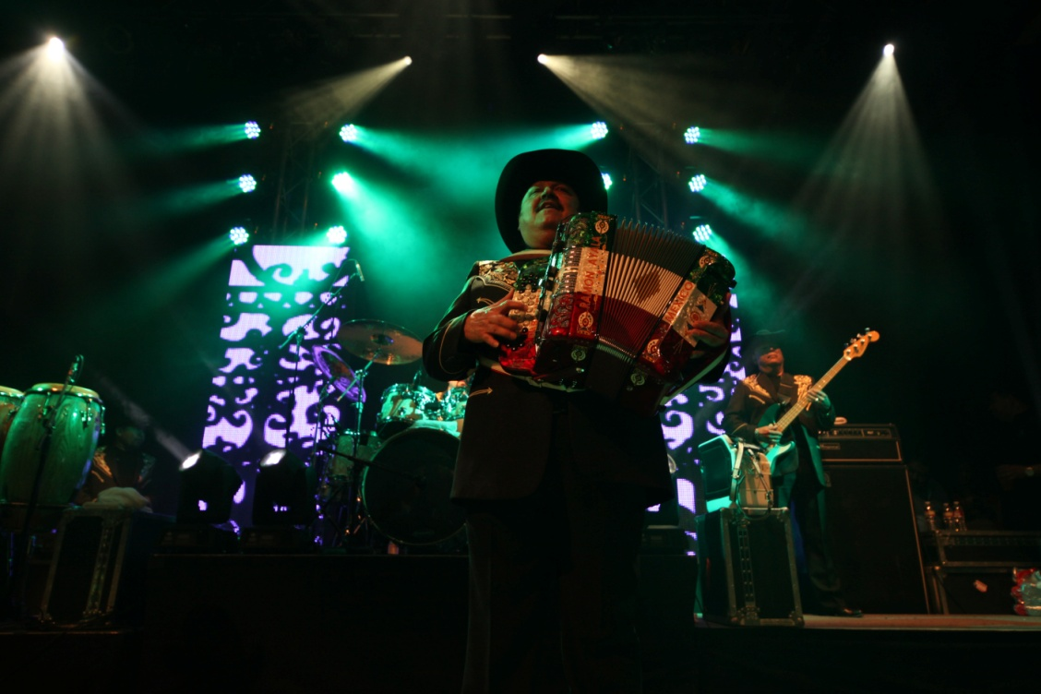
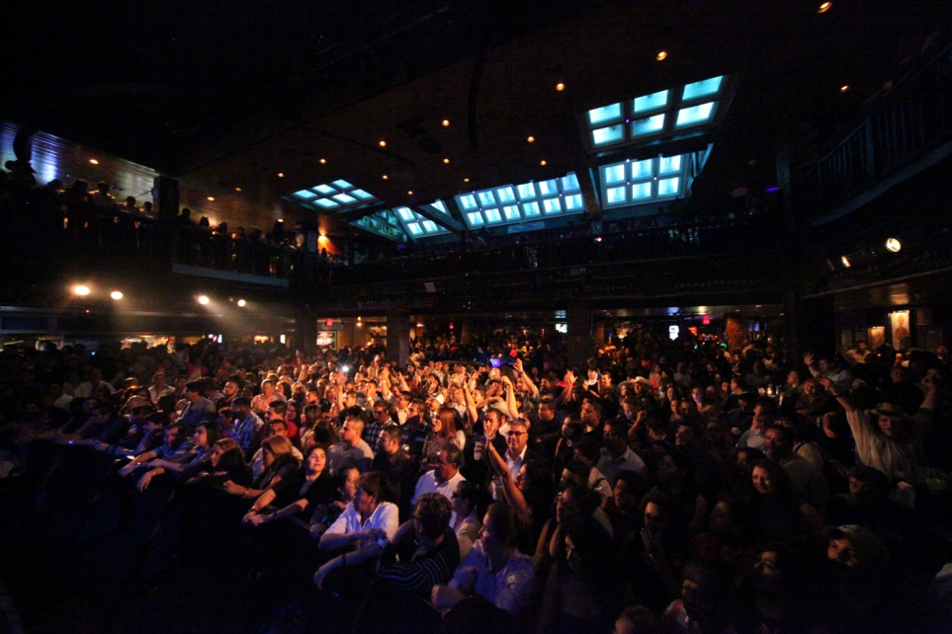
The Event:
ACA Marketing produced for 4th consecutive time a very exclusive and private concert for CURACAO
ACA Marketing has secured the biggest act in the Norteño Music genre, “The King of the Accordion”: RAMON AYALA
The event took place at the legendary venue The House of Blues on Sunset strip on May 2, 2013

Slide 3

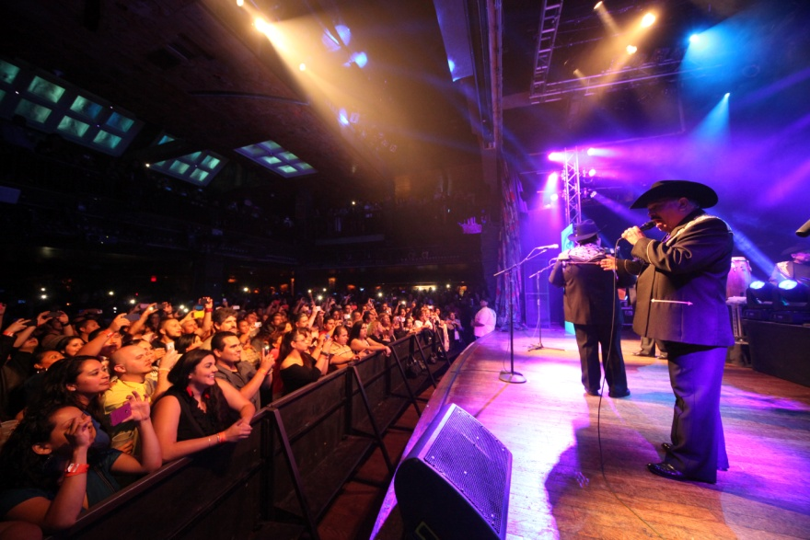
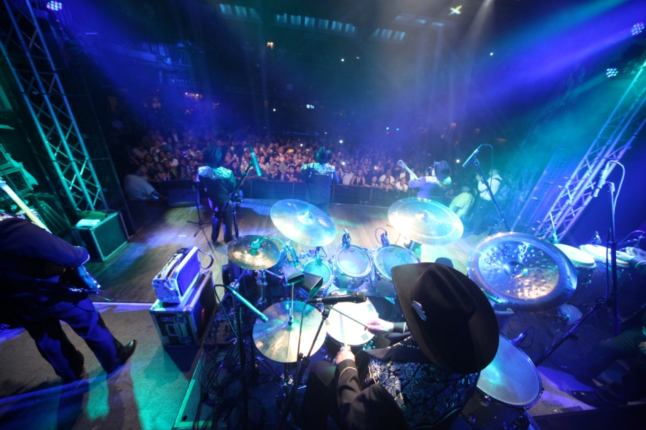
Who is ?
RECAP PRESENTATION
Sold over 50 million records
Released 107 albums
Recorded over 1,000 songs
Sold millions of concert tickets
2 Grammy awards
2 Latin Grammy Awards
Millions of searches on Goggle monthly
Presented with the Keys to the City of Coachella, CA

Slide 4

The Goal - Our Partnership :
To drive traffic to Curacao stores by offering the opportunity to win tickets to this private event with this special promotion.
To help Curacao sign new customers using concert tickets as an incentive
To continue the Concert Series establishing Curacao presence with the Latin Community in both first and second generation.
To increase sales with new customers by giving them the opportunity to use their new Curacao credit card
To present & promote SAMSUNG’s newest products

Slide 5
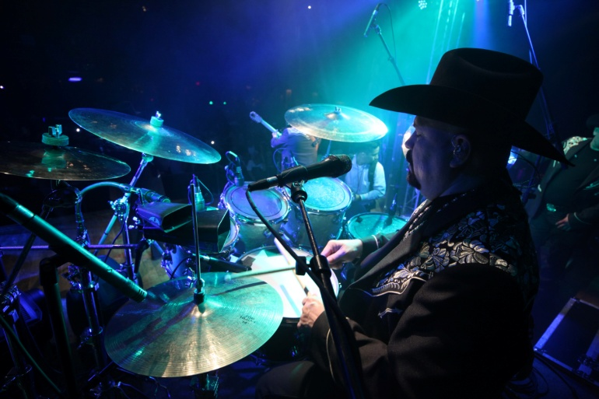
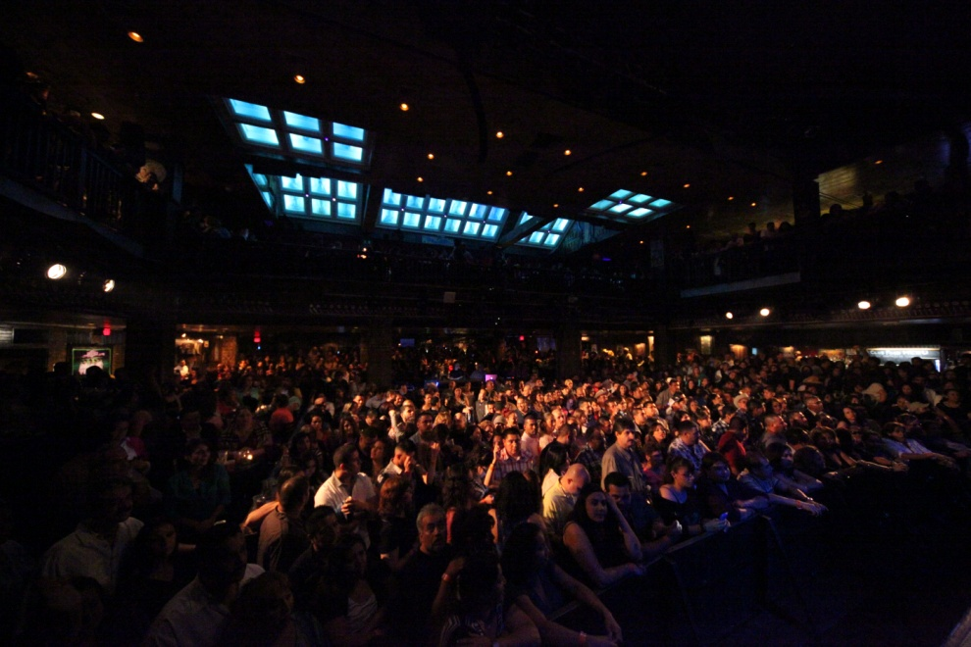
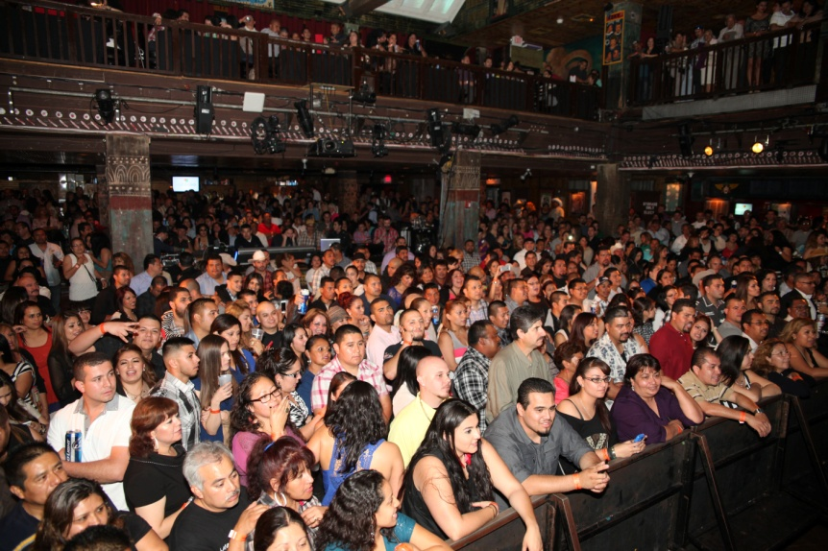
Benefits:
Curacao continues to bring the hottest concerts in town!
Curacao had the right to utilize Ramon Ayala’s name, logo and image for this promotional campaign including, radio, TV, Print, online.
Tickets were only available at Curacao stores
Curacao had the opportunity to bring SAMSUNG as sponsor
Curacao had several displays on-site promoting SAMSUNG’s products
Over 2,500 Tickets were given-away that read “Curacao Presents”

Slide 6
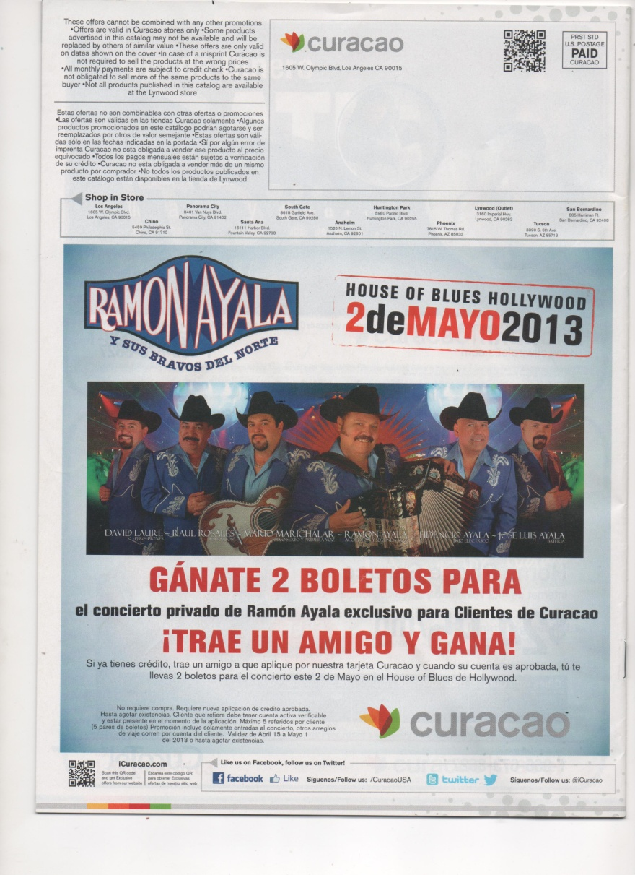
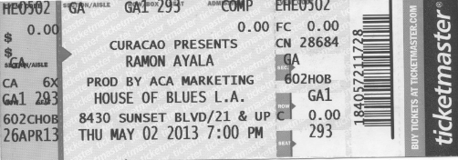
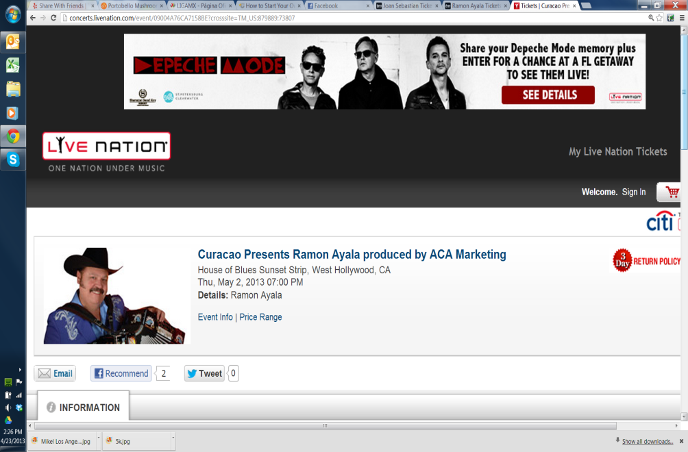
Curacao had the right to use RAMON AYALA’s image and name on all promotional materials & stores
More than 2,700 + Tickets were given away Curacao
RAMON AYALA’s name & image was used on Curacao May Catalog. Also Curacao was mentioned as presenting on promotion online including House of Blues website

Slide 7

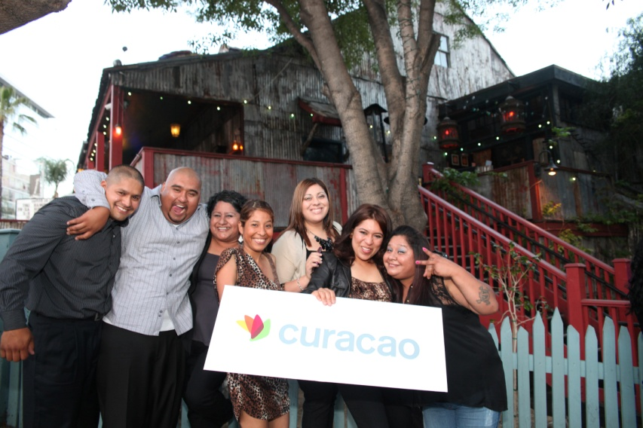
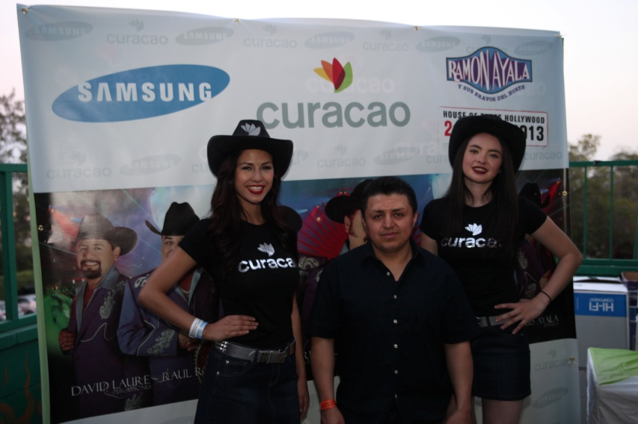
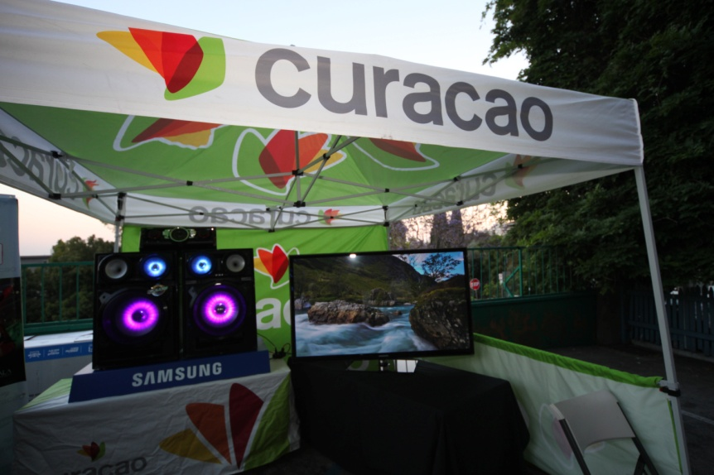
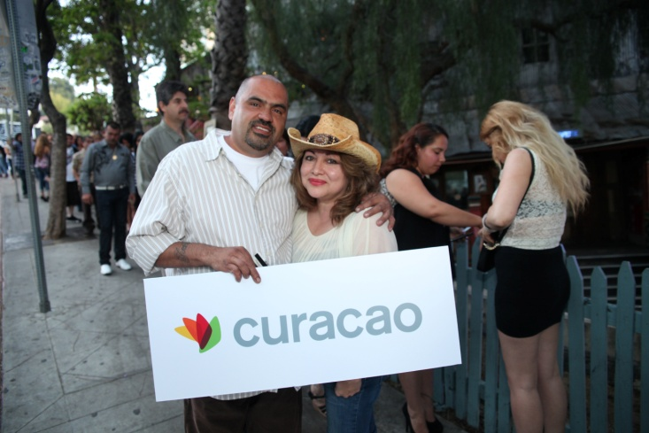
There was extensive signage at venue during the concert

Slide 8
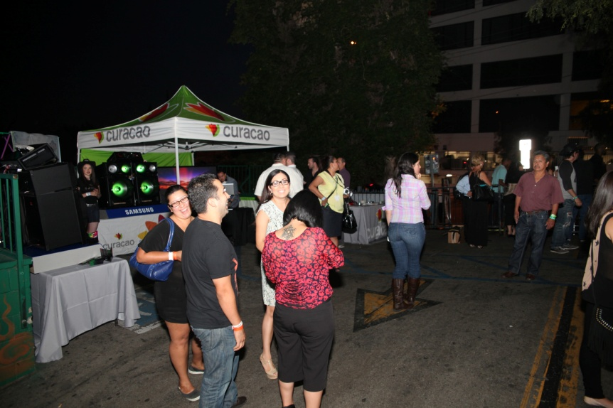
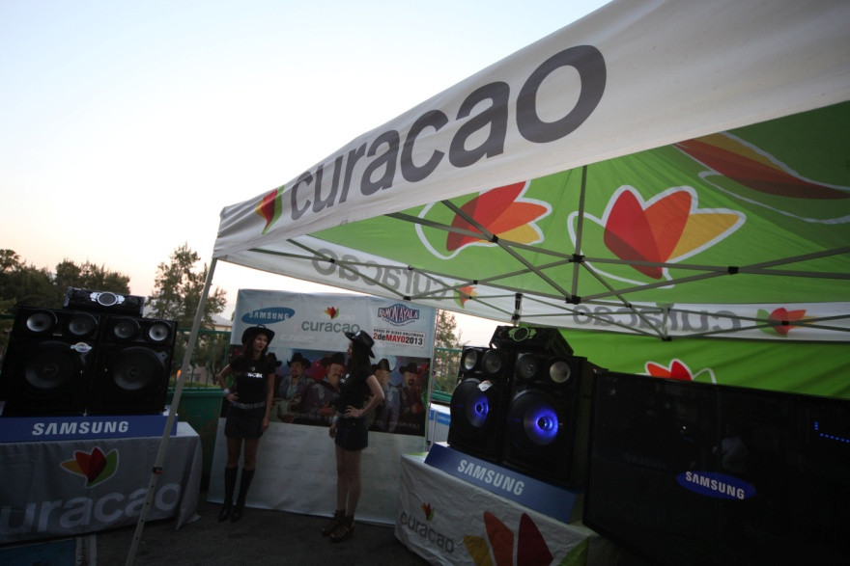
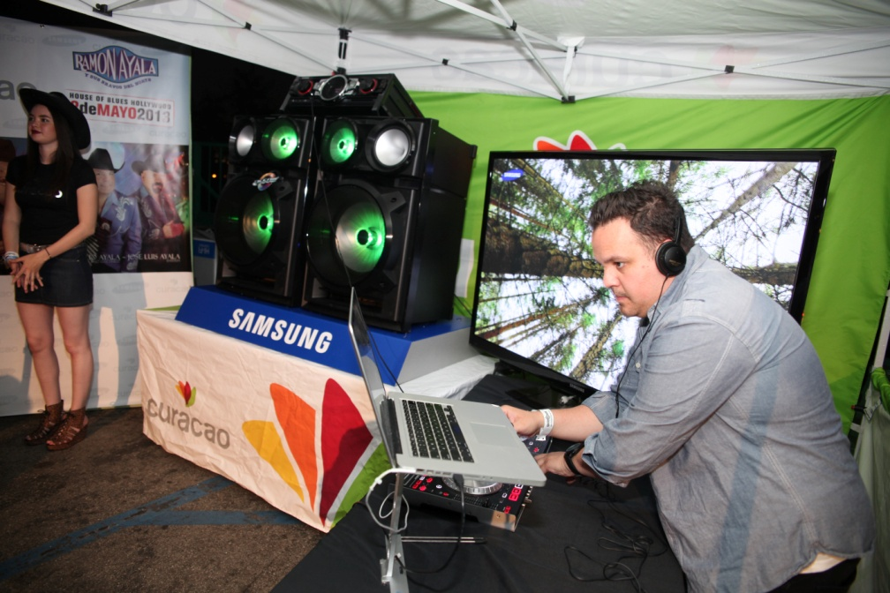
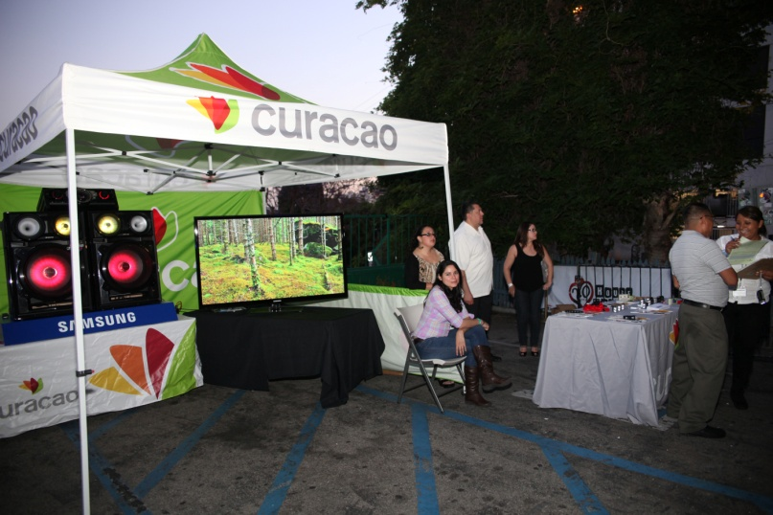
Special area for Curacao’s promotions team & Samsung's display onsite

Slide 9
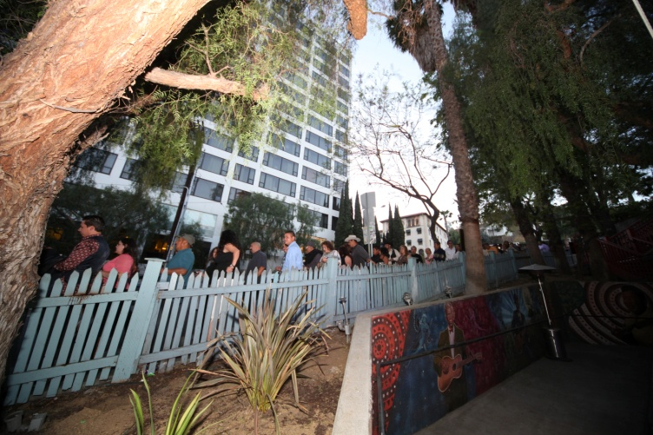
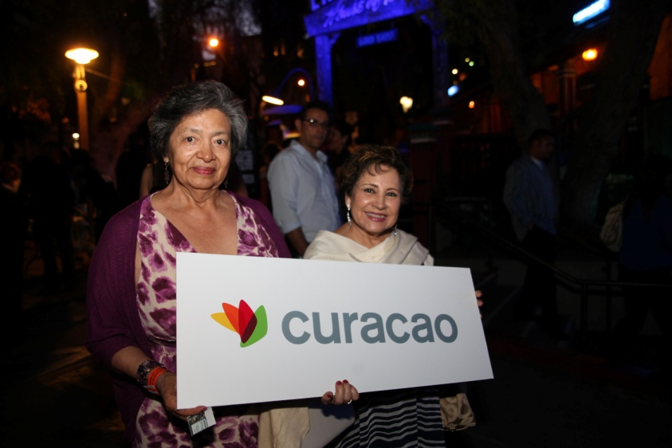
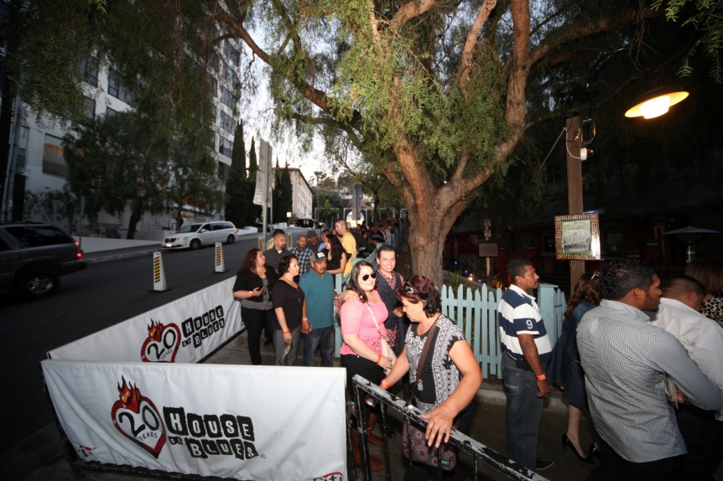
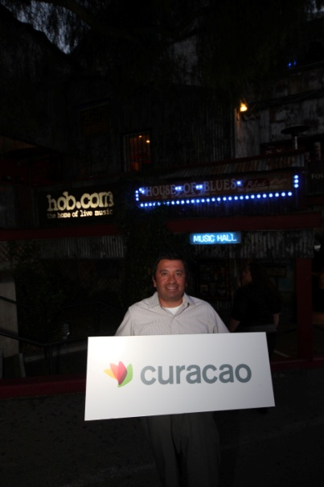
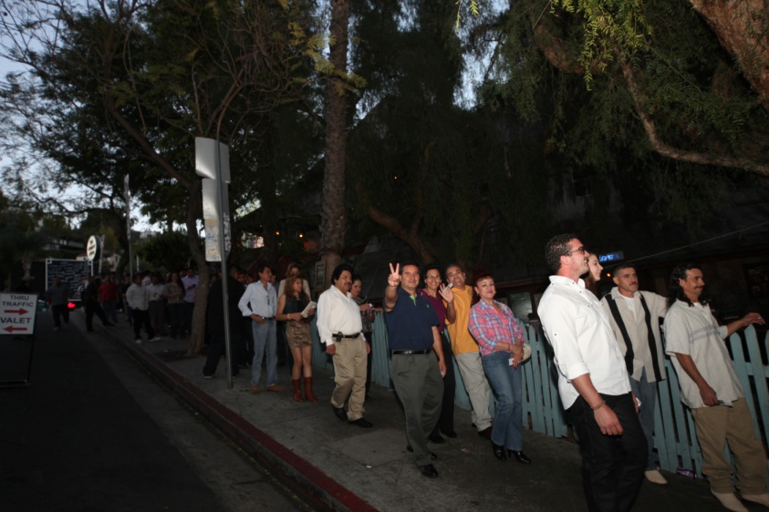
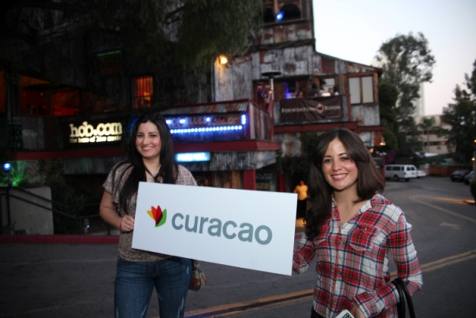
The event was packed!
There was a huge line to enter, all around Sunset Strip
Curacao’s new customers

Slide 10
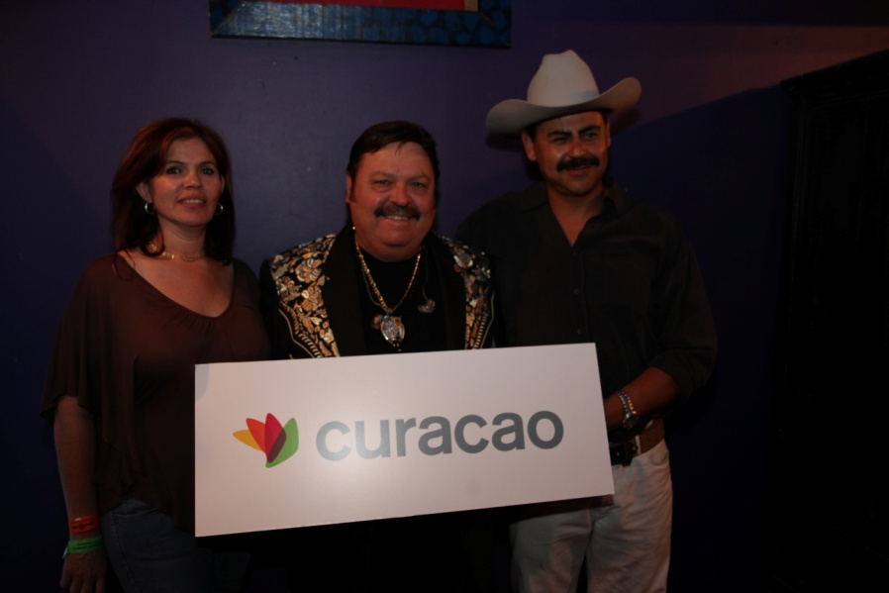
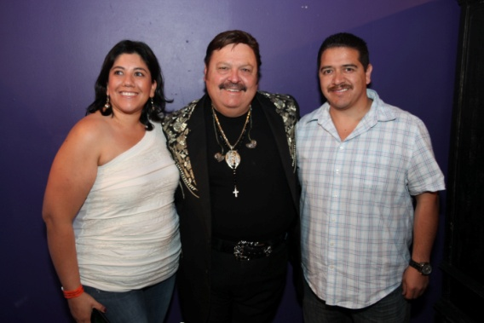
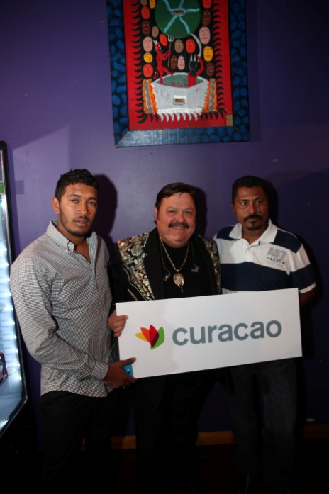
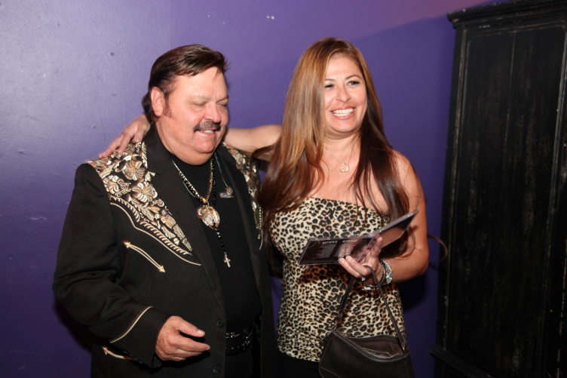
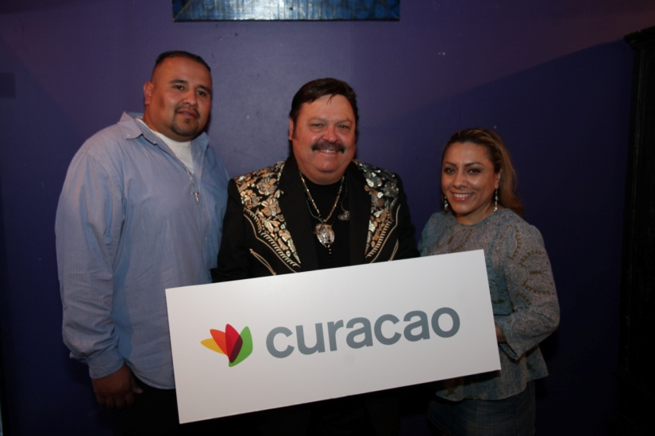
Opportunity for Curacao’s guests to M&G with RAMON AYALA on backstage

Slide 11

THE EVENT: WAS VERY SUCCESFULL WITH A FULL HOUSE ON A THURSDAY NIGHT!
THE CUSTOMERS: OVER 1,200 PEOPLE HAD THE OPPORTUNITY TO SEE UP AND CLOSE THE KING OF THE ACCORDION “RAMON AYALA” THANKS TO CURACAO!
THE RESULTS: MORE THAN 800 NEW CUSTOMERS APPROVED WITH CURACAO CREDIT CARD IN ONLY 2 WEEKS!!!
* * * * * * * * * * * * * * * * * * * * * * * * * * * * * * * * * * * * *
Produced by:
CONFIDENTIAL AND PROPRIETARY NATURE OF PRESENTAION: This presentation is proprietary to ACA Marketing. ACA Marketing reserves all rights in such presentation. Accordingly company agrees to protect the confidentiality of all information contained in this document, except as may be required by any applicable law, government order, or regulation, or by order or decree of any court of competent jurisdiction. Company shall not, without prior written consent of ACA Marketing, publicly divulge, announce or in any manner disclose to any unrelated third party, any information or matters revealed herein, or any of the specific terms and conditions of this proposal, and each party shall do all such things as are reasonably necessary to prevent any such information from becoming known to any party other than the parties to this presentation. ACA Marketing and company understand that there will be additional details, including but not limited to legal and financial details, which will require further negotiation and discussion between the parties. It is understood that ACA Marketing will not be obligated to company or any other entity until a written agreement approved by has been executed by both parties.
This presentation is of confidential and proprietary nature and its contents should not be reproduced or copied in whole or in part without authorization of ACA Marketing. The Presentation contains information generally available to the public from sources reasonably believed to be reliable. ACA Marketing and all associated companies however make no representations or warranties, express or implied, as to the accuracy or completeness of this information.

Slide 12
RECAP
PRESENTATION
Produced by:
www.acamarketing.net
www.facebook.com/acamarketing
Twitter.com/acamarketing

