Slide 1



RECAP
PRESENTATION
P R E S E N T S :
@ The House of Blues Sunset
April 22, 2010
Produced By:

Slide 2
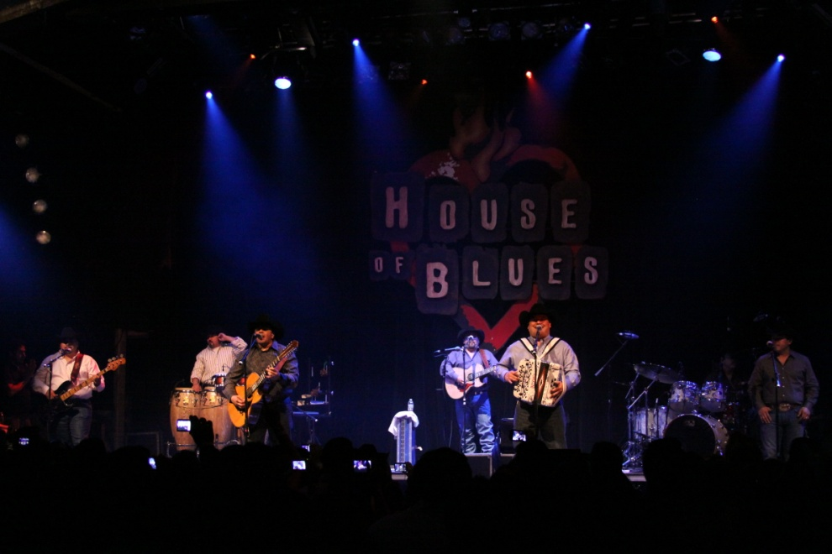

RECAP
PRESENTATION
The Event:
ACA Marketing produced a private concert for La Curacao
ACA Marketing secured one of the biggest acts from the regional music genre: “INTOCABLE”
The event took place at the legendary venue The House of Blues in Sunset strip on April 22, 2010
The event was private for only La Curacao’s customers and selected employees
The event was very exclusive for only 1,500 people.

Slide 3
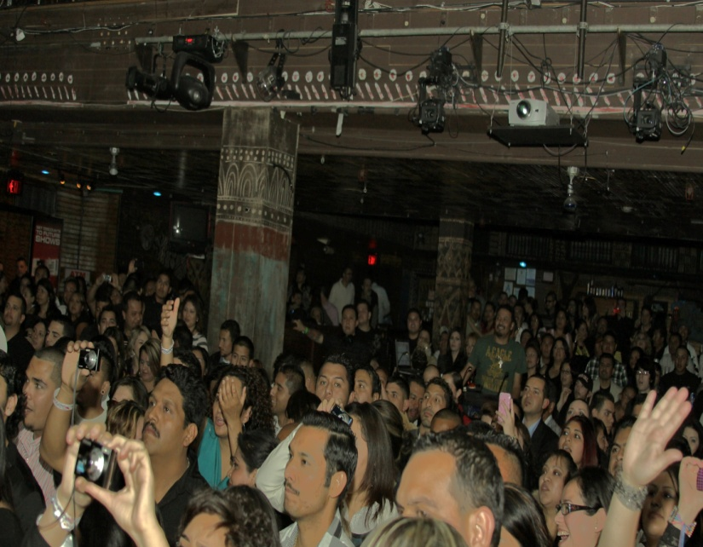
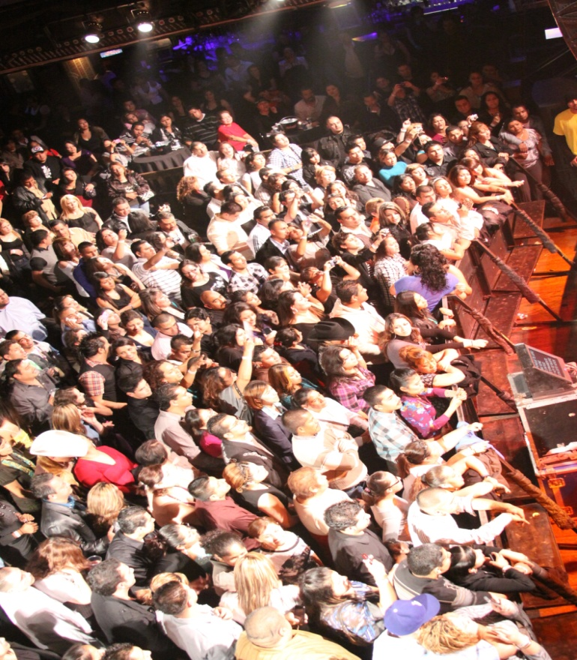

RECAP
PRESENTATION
The Goal:
Drive Traffic to La Curacao stores by offering the opportunity to win tickets to this private event
Increase sales during event promotional time
Promote La Curacao Department Store card
To bring an unique experience to La Curacao’s customers and employees
To find an event that would bring the dynamic of motivating both the La Curacao’s customers and employees
To develop an event that could be the start for a “Concert Series” owned by La Curacao

Slide 4
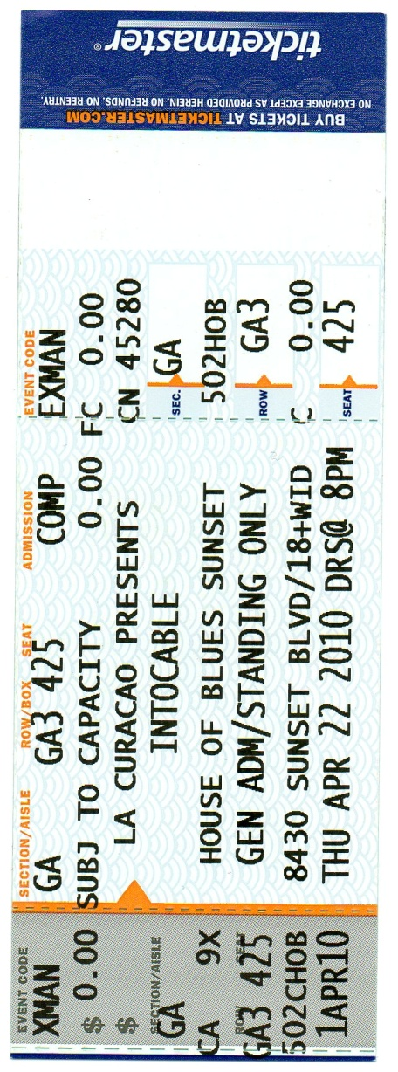



RECAP
PRESENTATION
1,500 Tickets given out @ La Curacao stores
La Curacao Bill Insert LA CURACAO DIRECT MAIL PIECE
Benefits:
La Curacao will be the “Presenting Sponsor” for the event.
The event will be promoted only with La Curacao media buy, at stores, store catalog & statements
All 1500 tickets to private event will say “La Curacao presents”
La Curacao will have the right to utilize INTOCABLE’s name, logo and image for promotional campaign
La Curacao to develop contest to win tickets only at stores to this private event
INTOCABLE to record a special tag for TV promotion for La Curacao

Slide 5
RECAP PRESENTATION
M E D I A B U Y
TV Media Buy - 45 spots at:
Telemundo
Channel 22
Estrella TV
Channel 62
Radio mentions at La Que Buena: About 60
Bill insert: 300,000 To all La Curacao's customers
Direct Mail: 100,000 to La Curacao Customers
*Information received from Teylez Perez - La Curacao

Slide 6
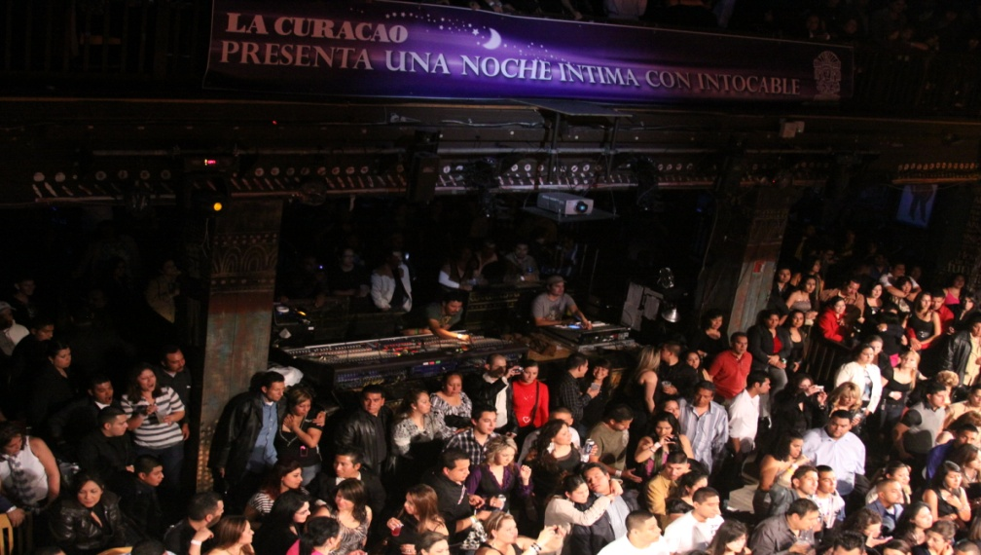
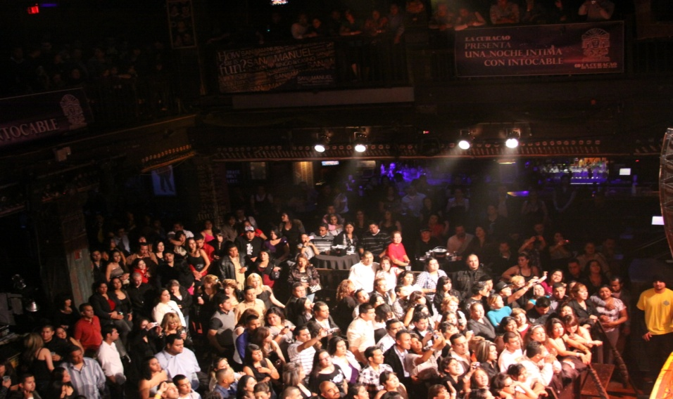
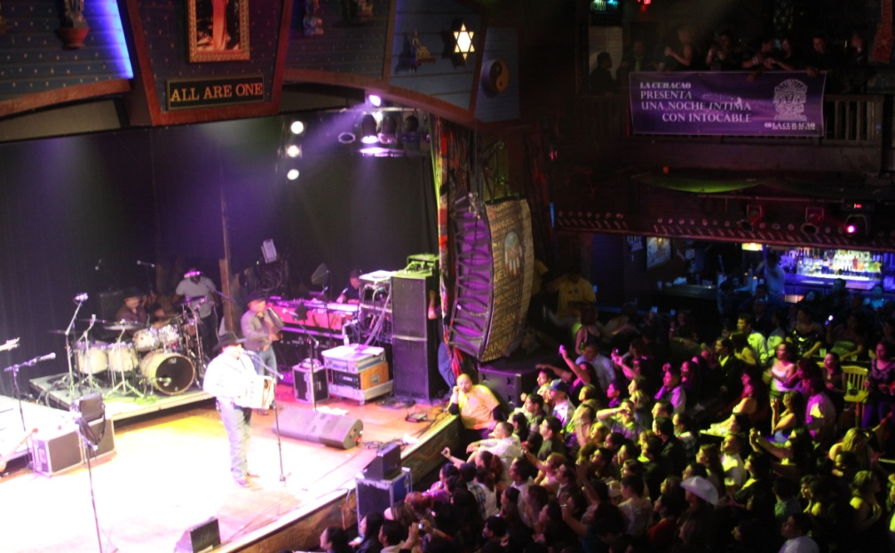
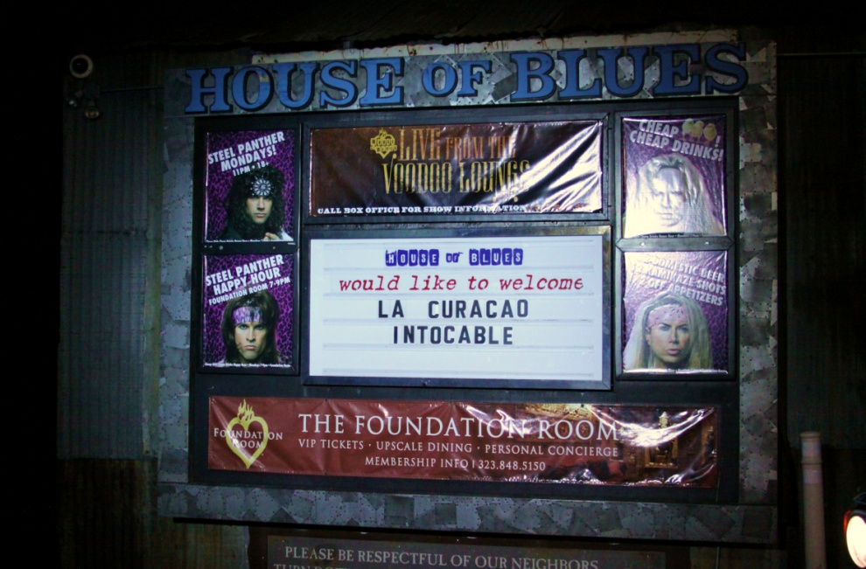
RECAP
PRESENTATION
Extensive signage at venue

Slide 7
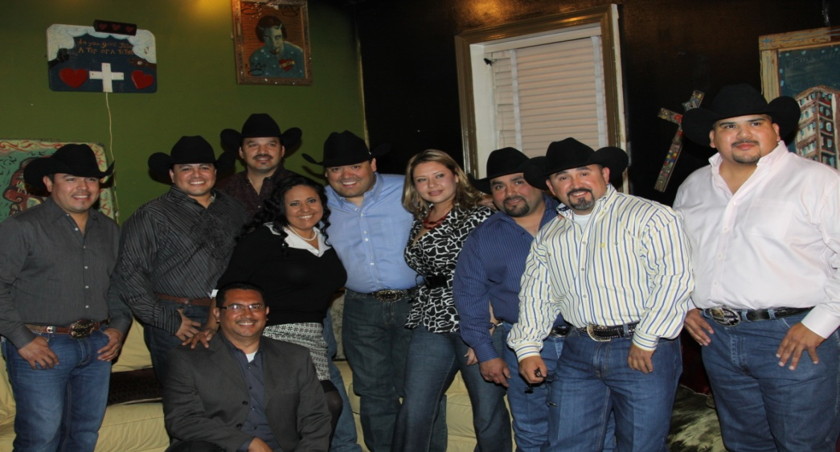
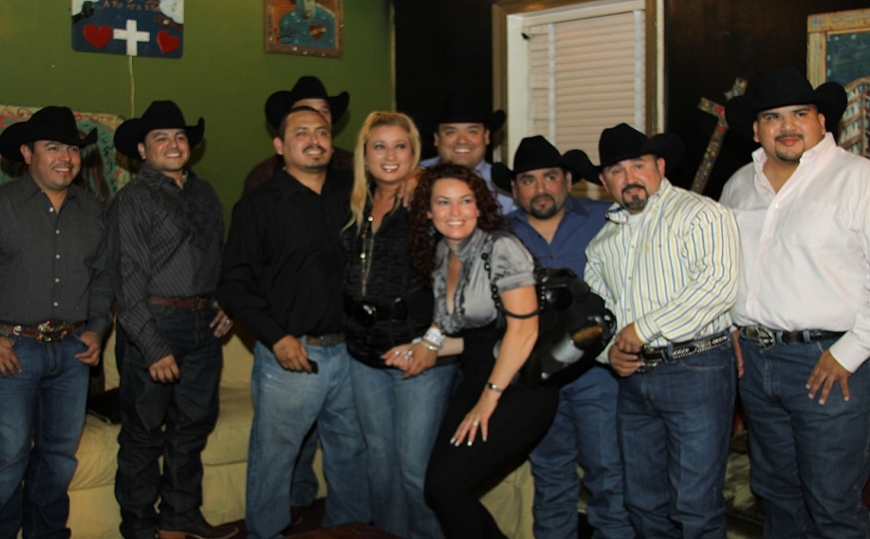
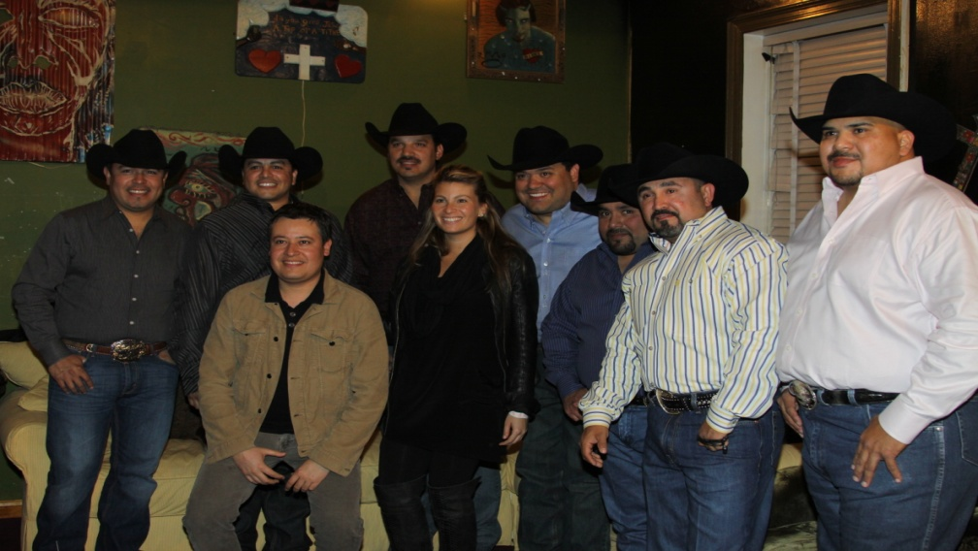
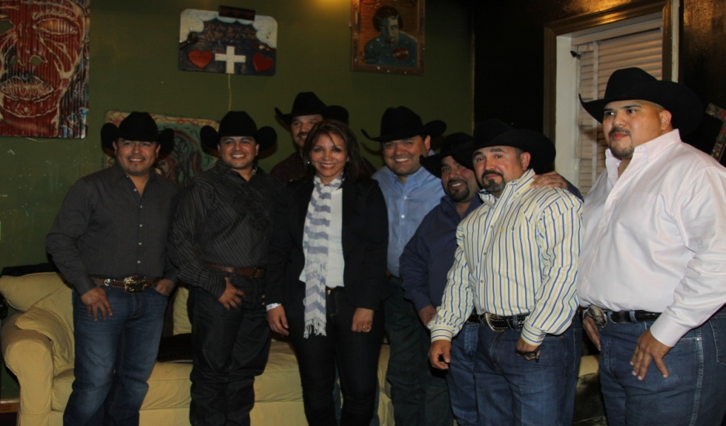

RECAP
PRESENTATION
La Curacao winners @ the VIP with INTOCABLE

Slide 8
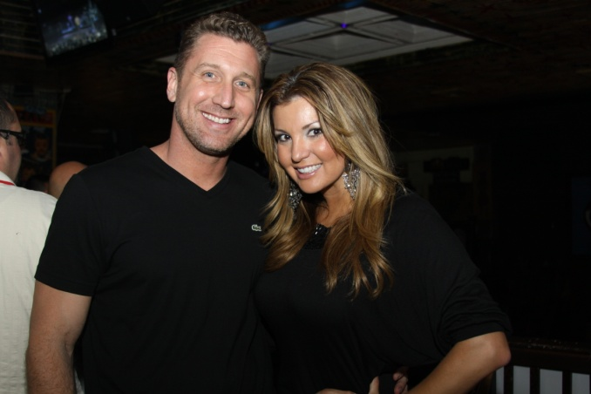
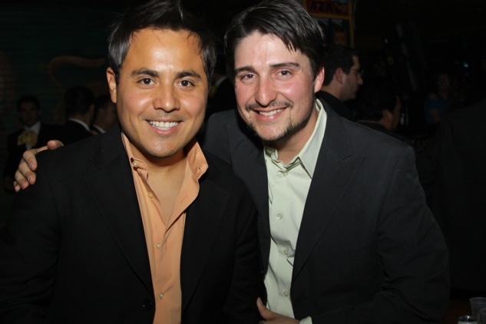
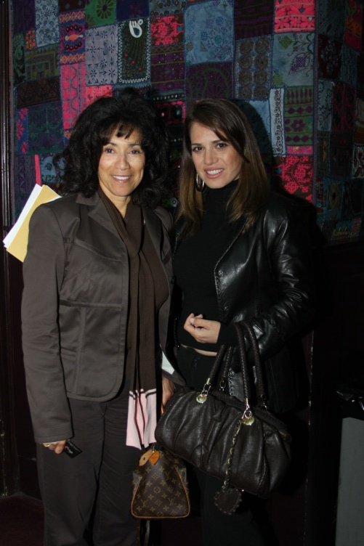
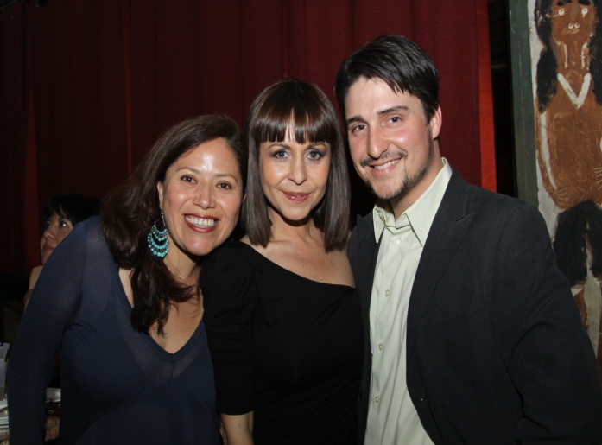
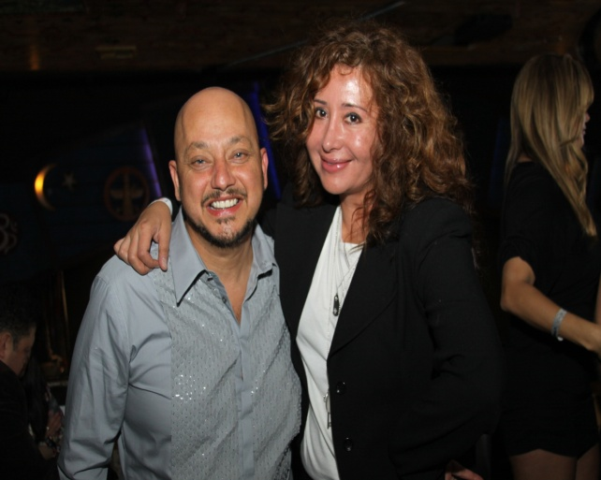

RECAP
PRESENTATION
Agnie Franco TV Azteca & Sean Valadez - ACA Marketing
Jason Garner CEO Live Nation & Ericka “La Huerquilla” Radio Personality Super Estrella
Emily Simonitsch Vice President Special Markets - Gibson Amphitheater & Ayelet Corona - ACA Marketing
Maria Garcia News Anchor - Telemundo
Pepe Garza Program Director La Que Buena &
Jessica Maldonado TV Personality - Univision
Media personalities and important industry representatives attended the event.

Slide 9
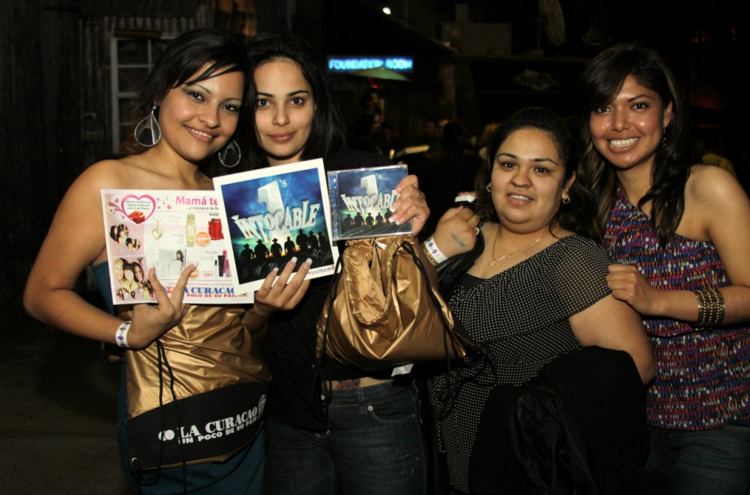
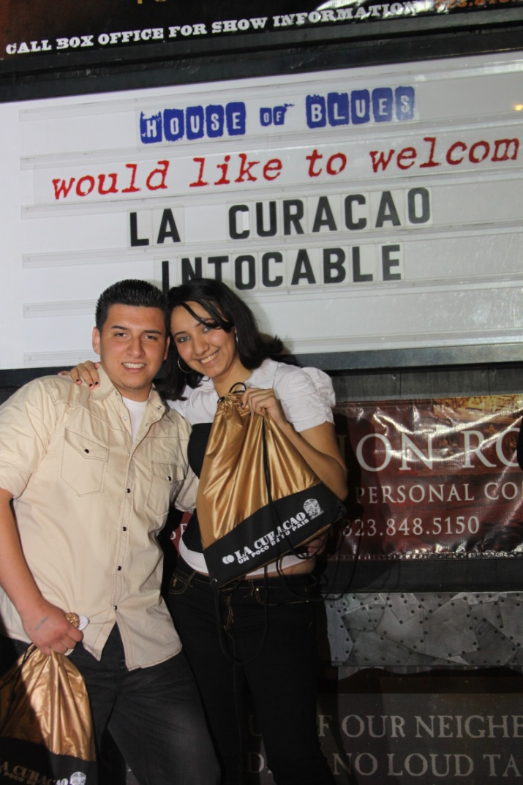
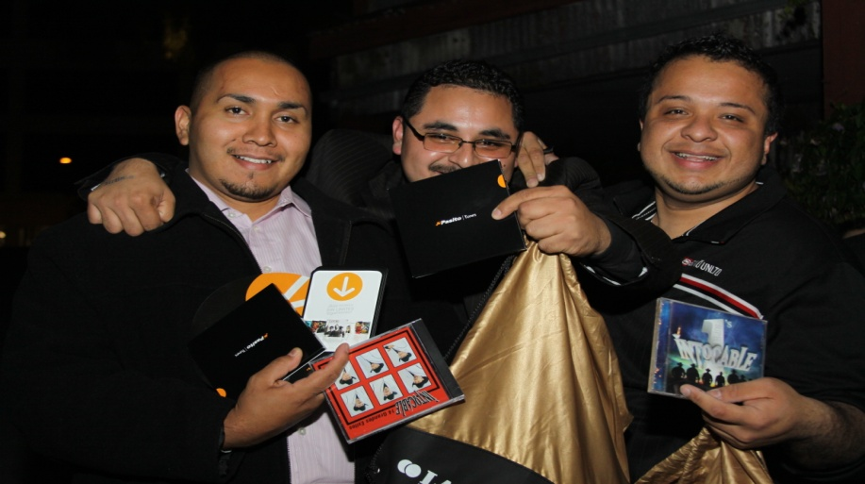
RECAP
PRESENTATION
All private concert attendees received a goodie bag with the latest “INTOCABLE” CD, autographed Intocable Picture & promotional materials such as the catalog, Pasito tunes materials, discounted offers etc to remember this special night brought by La Curacao!!

Slide 10
RECAP
PRESENTATION
Event’s Comments from general public, HOB reps and band members:
“Very well organized event”
“Amazing opportunity to see our favorite band so closed thanks to La Curacao”
“Can’t believe the band played for 1:30 minutes!! Not even when I pay for the ticket the bands play that long!”
“One of the best shows I’ve seen and not only it was free but I even got a goodie bag!”
“Please continue bringing your business to our venue” HOB rep
“Production and organization in general was flawless” HOB Production rep.
“I wish all concerts were like this one!” Intocable band members

Slide 11
RECAP
PRESENTATION
Artists that want to participate in La Curacao Concert Series:
Espinoza Paz (Regional Mexican)
Jenni Rivera (Regional Mexican)
Los Tucanes de Tijuana (Regional Mexican)
Paquita la del Barrio (Regional Mexican)
Banda Limon (Regional Mexican)
Banda Tierra Cali (Regional Mexican)
Larry Hernandez (Regional Mexican)
Conjunto Primavera (Regional Mexican)
Aleks Syntek (Pop)
Obbie Bermudez (Pop)
Kinky (World- electro)

Slide 12
RECAP
PRESENTATION
Produced by:
www.acamarketing.net
www.facebook.com/acamarketing
Twitter.com/acamarketing

